Slide 1
A closer look at Methods & Classes
Object Oriented Programming
Lecture # 9
Prepared by: Mehak Usmani

Slide 2
Content
Object as Parameter
Argument Types
Passing Objects to Methods

Slide 3
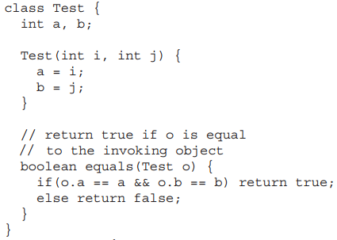
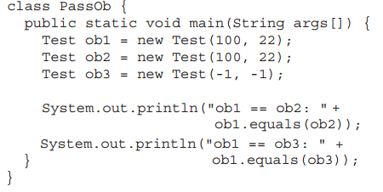
Objects as Parameters
Just like using simple types as parameters, it is both correct and common to pass objects to methods.

Slide 4
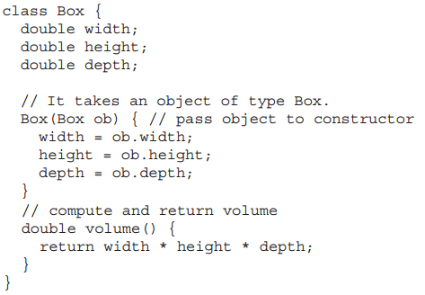
Objects as Parameters
One of the most common uses of object parameters involves constructors. Frequently, a construct is required to create a new object that it is initially the same as some existing object.

Slide 5
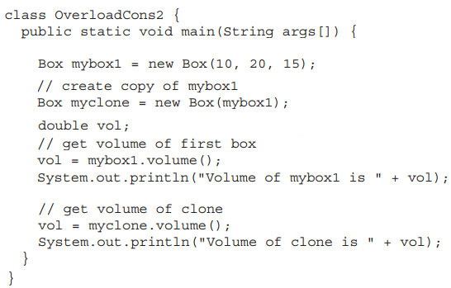
Objects as Parameters
Output:
Volume of the mybox1 is 3000
Volume of the clone is 3000

Slide 6
Argument Passing
In general, there are two ways that a computer language can pass an argument to a subroutine.
call-by-value This approach copies the value of an argument into the formal parameter of the method. Therefore, changes made to the parameter of the method have no effect on the argument.
call-by-reference In this approach, a reference to an argument (not the value of the argument) is passed to the parameter. Inside the method, this reference is used to access the actual argument specified in the call. This means that changes made to the parameter will affect the argument used to call the method.

Slide 7
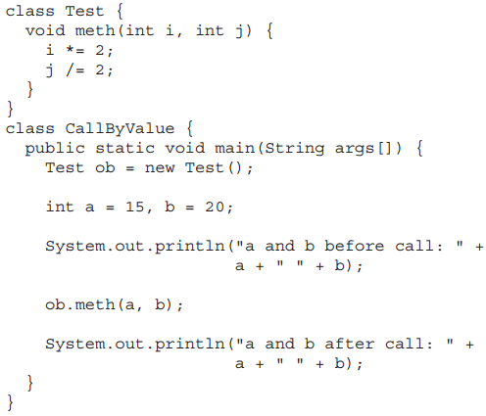

call-by-value
When a primitive type argument is passed to a method, it is passed by value.
Output

Slide 8
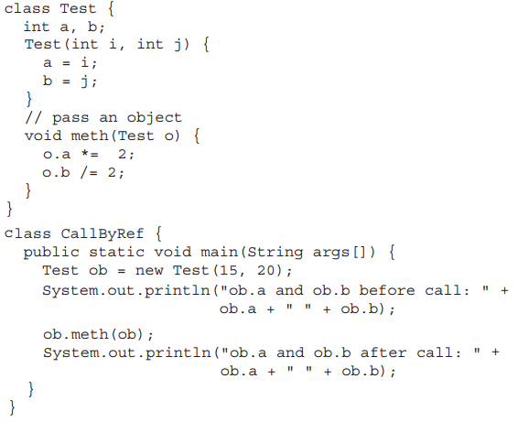

call-by-reference
When reference type argument is passed to a method, the parameter that receives it will refer to the same object.
Output

Slide 9
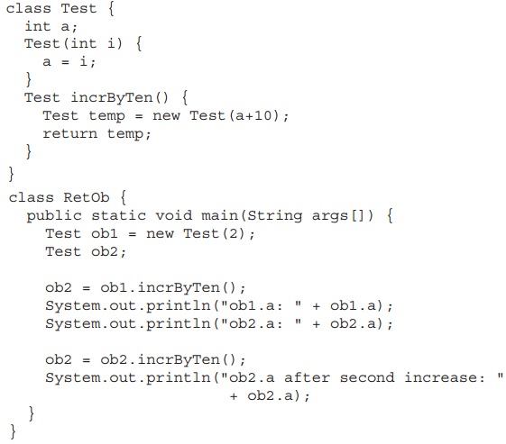

Returning Objects
A method can return any type of data, including class types that is created.
Output

Slide 10
Returning Objects
Output
Is an object going out-of-scope?

Slide 11
Returning Objects
A method can return any type of data, including class types that is created.
Output
No
The object will continue to exist as long as there is a reference to it somewhere in the program. When there are no references to it, the object will be reclaimed the next time garbage collection takes place.

Slide 12
Array of Objects
Circle[] circleArray = new Circle[10];
An array of objects is actually an array of reference variables.
So invoking circleArray[1].getArea() involves two levels of referencing as shown in the next figure.
circleArray references to the entire array.
circleArray[1] references to a Circle object.

Slide 13
Array of Objects
Circle[] circleArray = new Circle[10];

